Slide 1

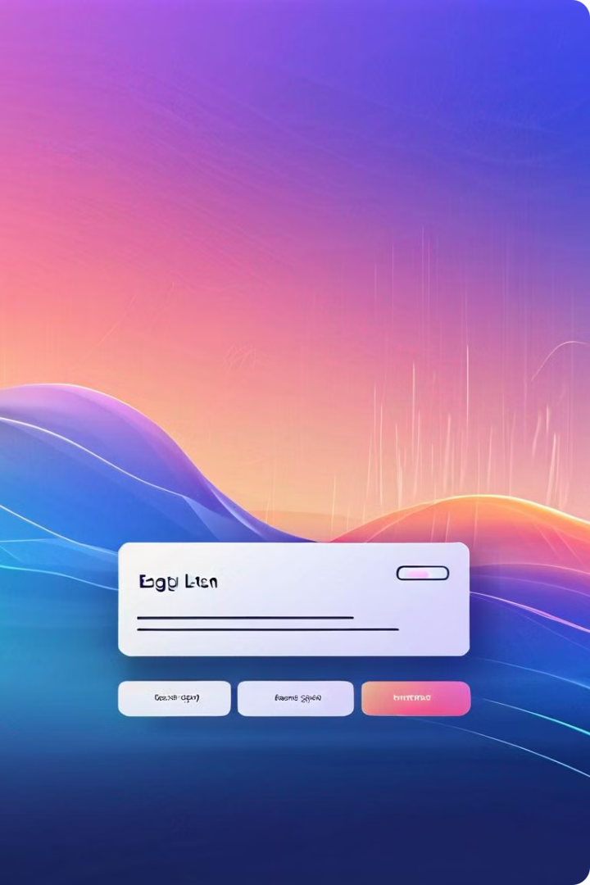
Login Page Design
Creating an intuitive and visually appealing login page is crucial for user engagement and security. The design should be clean, responsive, and focused on guiding users through the authentication process seamlessly.
RP
by
Sarveshwaran A
Pandian M
Mohamed Fayas A
Rishwanth R

Slide 2
User Authentication
Secure Authentication
User-Friendly Experience
Accessibility Considerations
Implement strong authentication methods, such as password hashing, two-factor authentication, and secure session management to protect user accounts.
Ensure the login process is straightforward and intuitive, with clear instructions and error handling to help users navigate the authentication flow.
Design the login page to be accessible for users with disabilities, following best practices for keyboard navigation, screen readers, and color contrast.

Slide 3
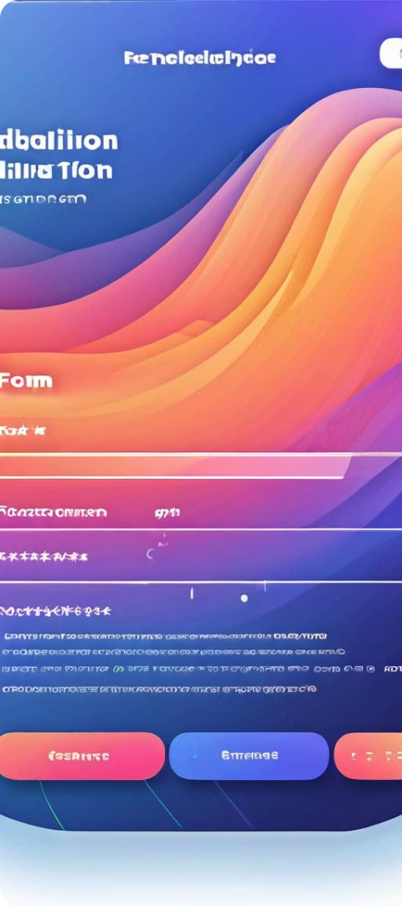
Registration Process
1
User Input
Collect only the necessary user information, such as username, email, and password, to minimize friction and enhance privacy.
2
Data Validation
Implement robust data validation to ensure user inputs are valid and secure, preventing common vulnerabilities like SQL injection.
3
Account Activation
Provide a clear and user-friendly account activation process, such as email verification, to confirm the user's identity and protect against spam.

Slide 4
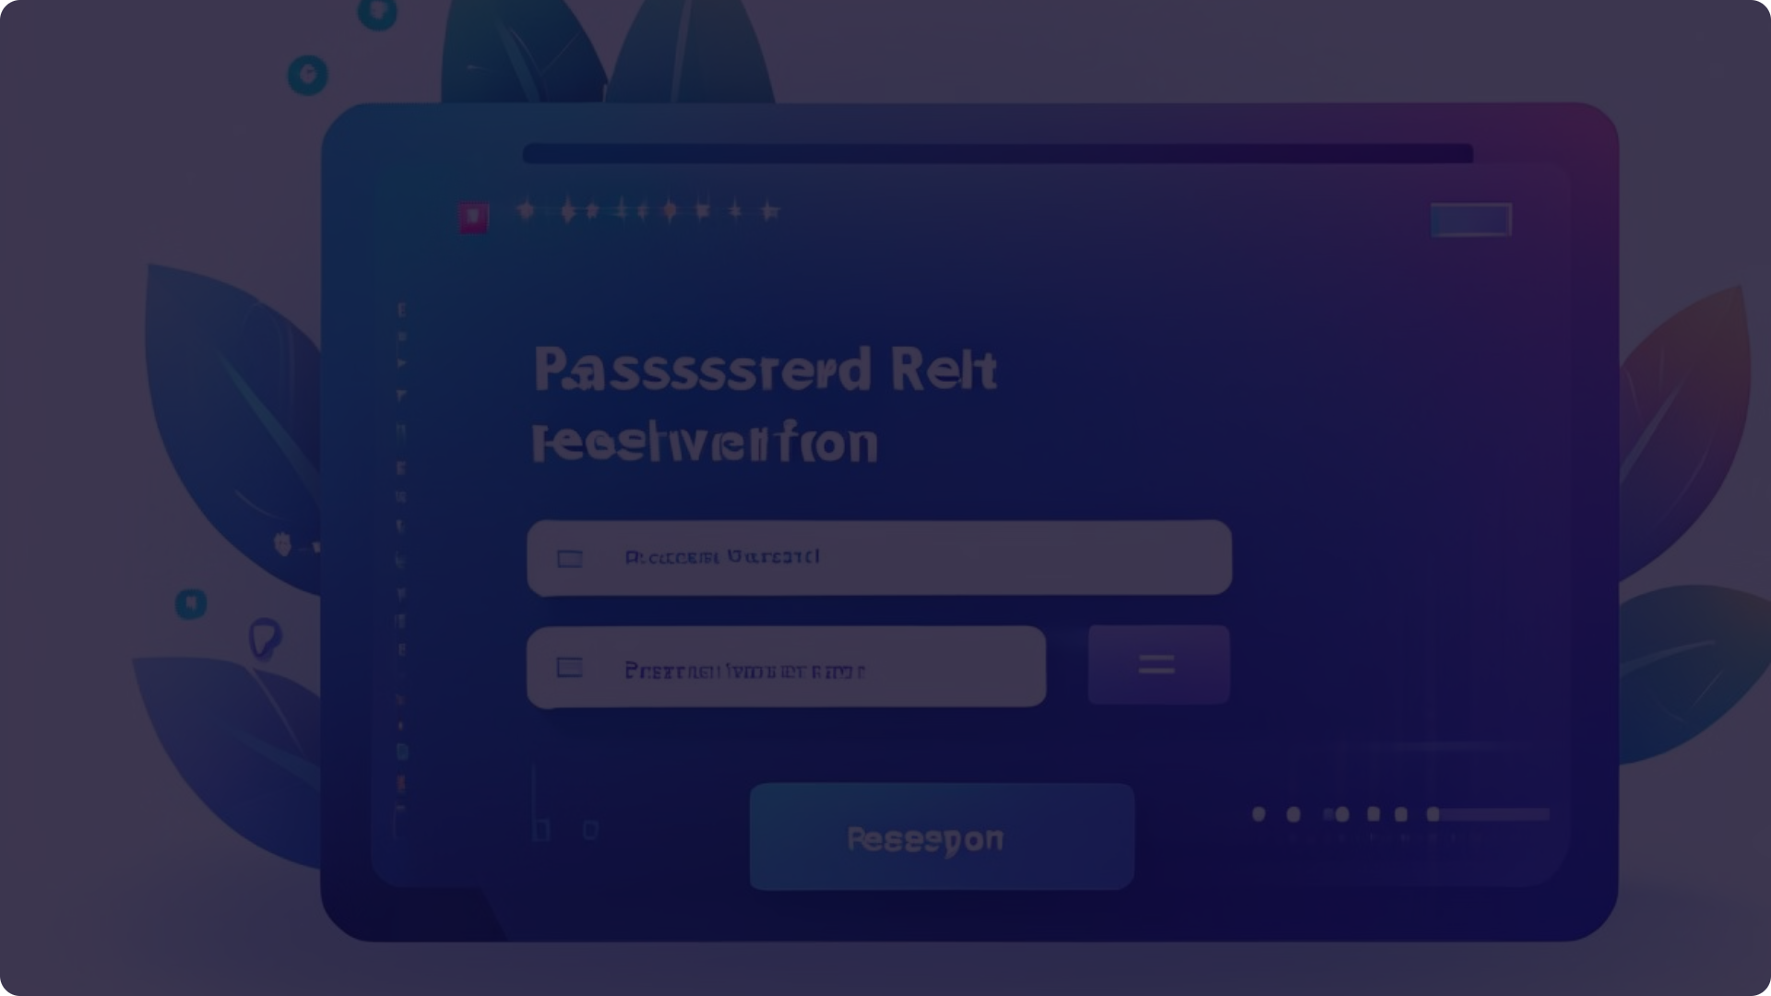
Forgot Password Functionality
1
Reset Password Request
2
Password Reset Validation
3
Password Reset Confirmation
Allow users to request a password reset through a secure and intuitive interface, such as an email-based reset process.
Implement robust validation to ensure the password reset request is legitimate and the new password meets security standards.
Provide clear confirmation and feedback to the user when the password reset is successful, reassuring them that their account is secure.

Slide 5




Social Media Integration
Facebook
Google
Twitter
Apple
Allow users to sign in using their Facebook account, providing a convenient and familiar authentication method.
Integrate Google Sign-In to enable users to authenticate with their Google accounts, streamlining the login process.
Offer Twitter-based authentication, giving users another option to log in to your application using their social media credentials.
Implement Apple Sign-In to provide users with a secure and privacy-focused authentication method using their Apple accounts.

Slide 6




Secure Login Protocols
HTTPS
CSRF Protection
Session Management
Ensure all login-related communication is encrypted using the HTTPS protocol to protect user data and prevent eavesdropping.
Implement Cross-Site Request Forgery (CSRF) protection mechanisms to safeguard against unauthorized access attempts.
Employ secure session management techniques, such as using session tokens and enforcing session timeouts, to maintain user sessions safely.

Slide 7
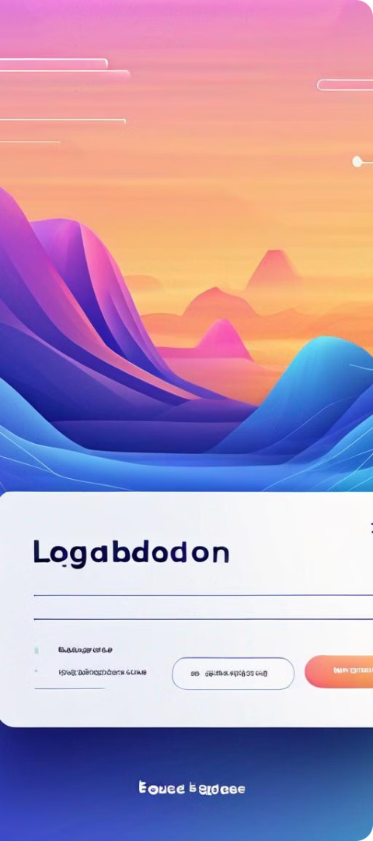
Responsive and Accessible Design
Mobile-Friendly
Accessibility Standards
Ensure the login page is fully responsive and optimized for various screen sizes, providing a seamless user experience on mobile devices.
Adhere to Web Content Accessibility Guidelines (WCAG) to make the login page accessible to users with disabilities, such as providing keyboard navigation and proper color contrast.
Intuitive Navigation
Design the login flow with clear and intuitive navigation, including easy-to-find password reset and registration options, to enhance user experience.

Slide 8

Conclusion and Call-to-Action
By implementing a well-designed login page with robust user authentication, secure protocols, and responsive accessibility, you can provide users with a seamless and secure login experience, ultimately improving overall user engagement and satisfaction.

